Slide 1
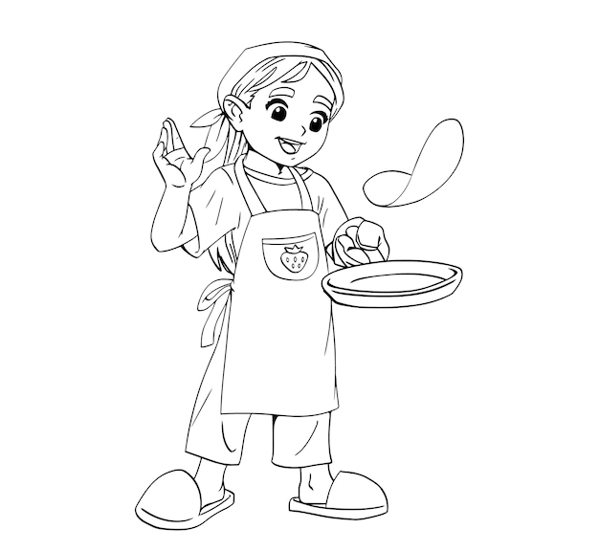

RESTAURANT MANAGEMENT SYSTEM
PYTHON SPECIALIZATION TRAINING PROJECT

Slide 2

TEAM:
Bharath Nagireddy -6562 (Team Lead)
Golla Dinesh -6542
Ganga Bhavani -6544
Kiran Chinnaswamy -6549
Ruchitha Cheekala -6556

Slide 3


Problem statement:
Given to order food from online restaurant

Slide 4

Architecture:
For ordering food
Once ordering finish
User login
LOGIN
Login
INDEX PAGE
FOOD ORDERING
ORDER
STATUS
If any problem wants to convey
If not registered
For checking order conformation
If admin login
ADMIN
To check before ordering
SIGNIN
CONTACT US
BILLING
To check before ordering
ADDING & DELETING
PRODUCTS
CONTACT DETAILS
ORDER STATUS
HISTORY

Slide 5

SOFTWARE USED:
FRONT END
HTML
CSS
JAVA SCRIPT
BOOT STARP
J QUEIRES
BACK END
ALGEY TOOLS:
PYTHON
DJANGO
MYSQL
Hosting Application
Aws

Slide 6
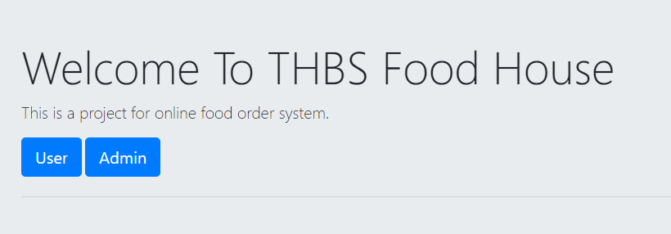
SAMPLE SCREENSHOTS:
Welcome page-

Slide 7
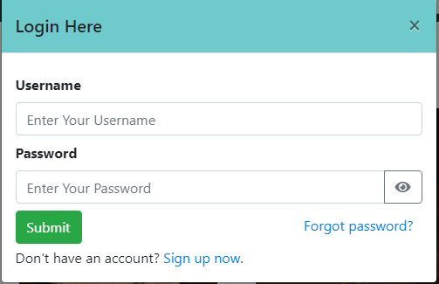
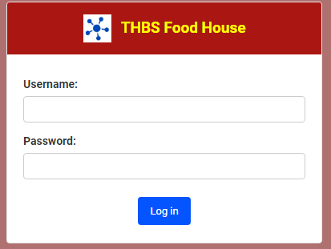
User Login-
Admin Login-

Slide 8
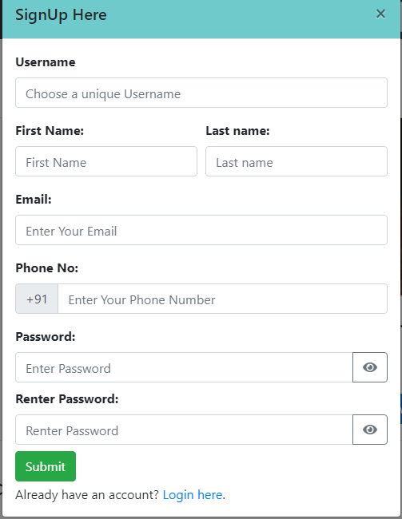
Signup-

Slide 9
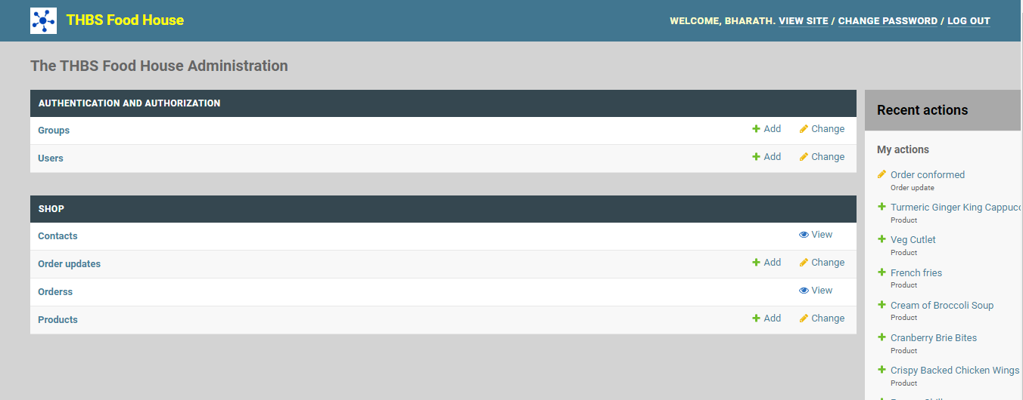
Admin homepage-

Slide 10
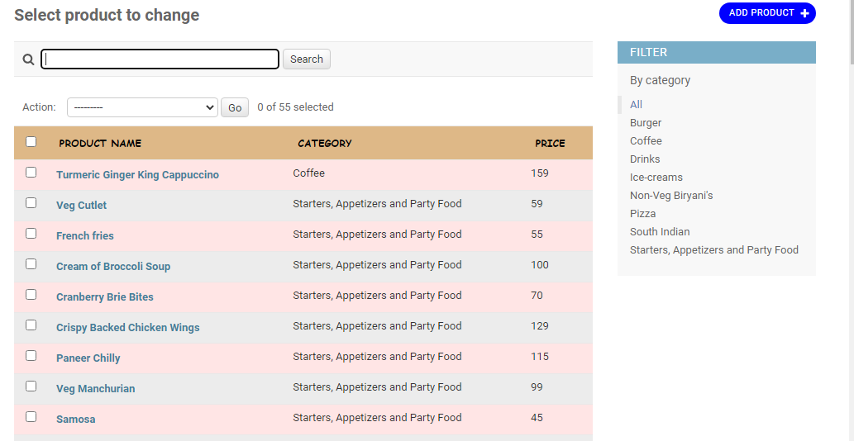
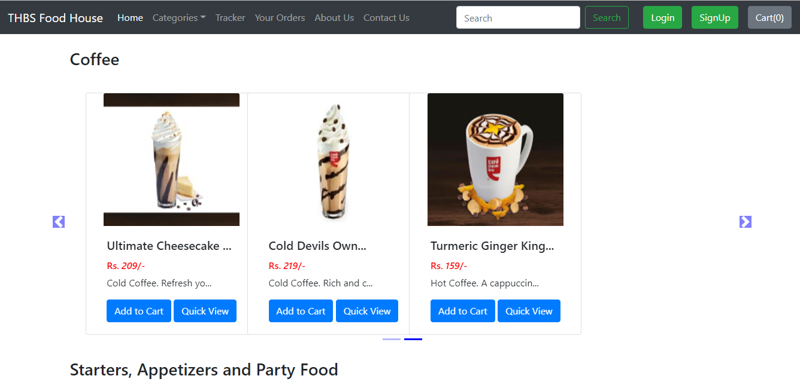
Adding Products-

Slide 11
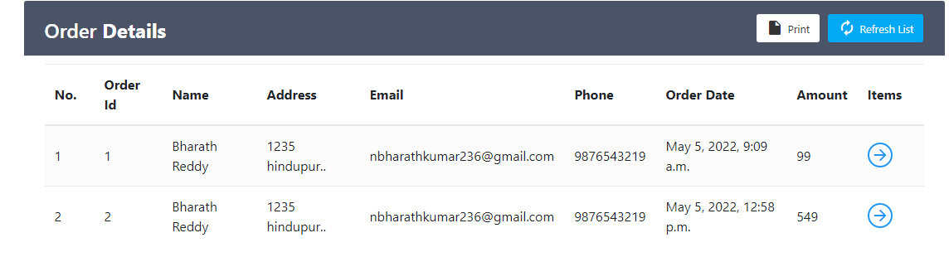
Food ordering-

Slide 12
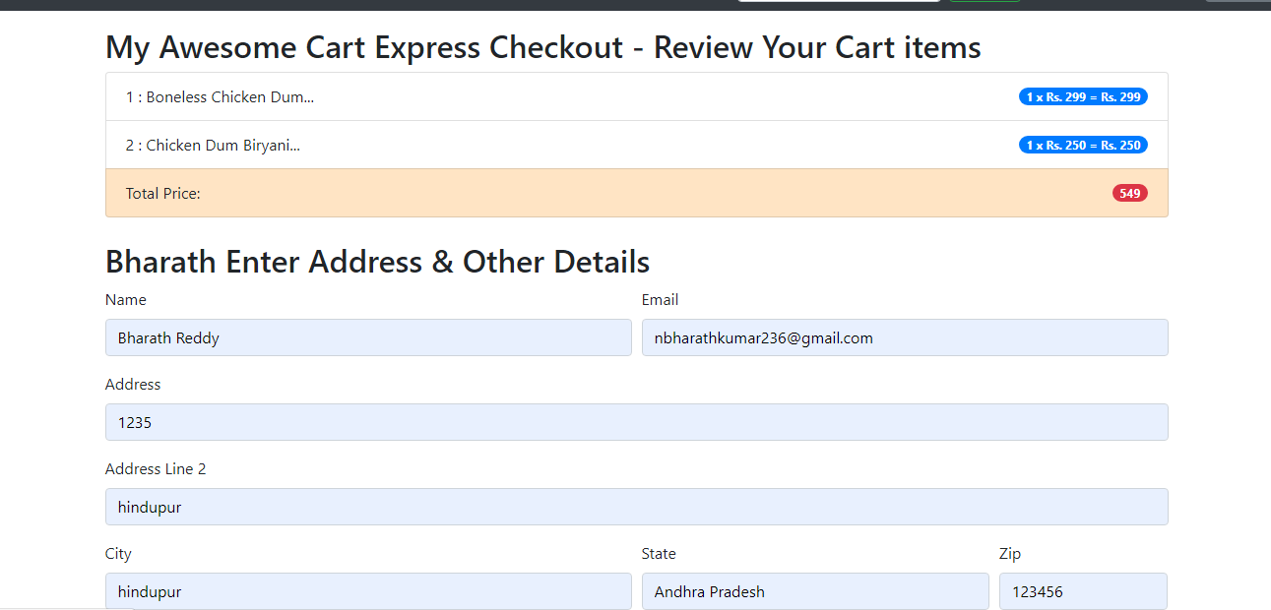
Checkout-

Slide 13


